Slide 1
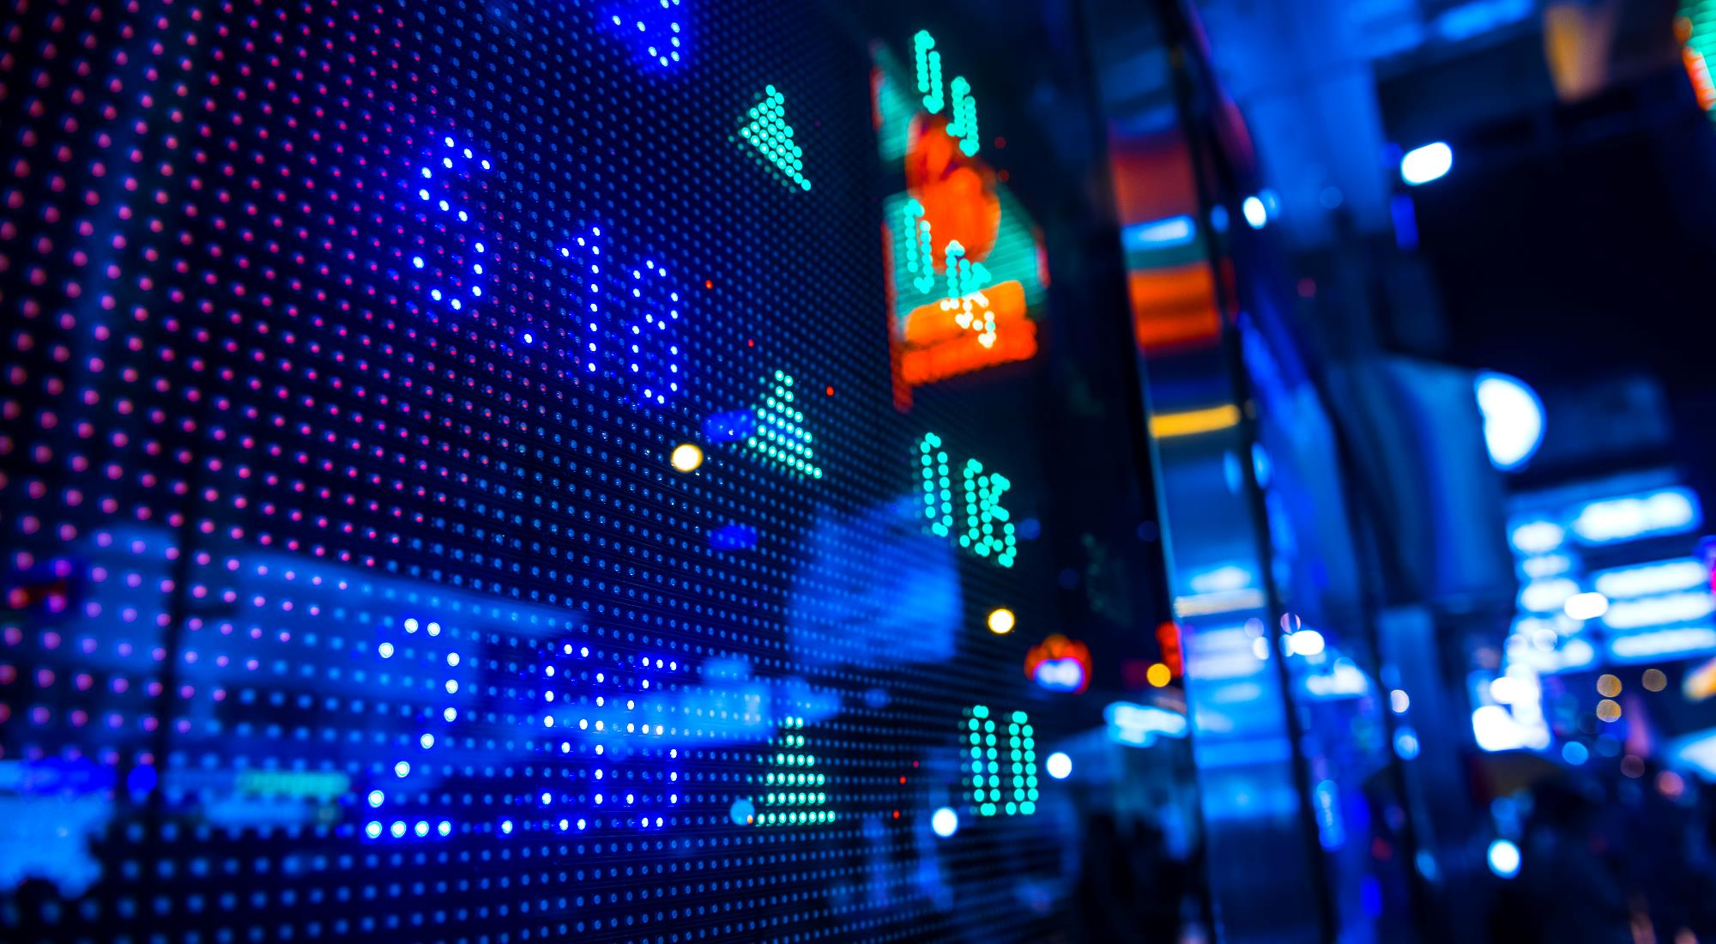

Sign language recognition app project
B21 – CAP0436 :
Andi josua simanullang lie Reynaldo ivander gunawan
Nafarel triyoga maskuncoro hezkiel rivaldo siregar
Nur ardli rachmat saputra darell adham kumara damaraji

Slide 2

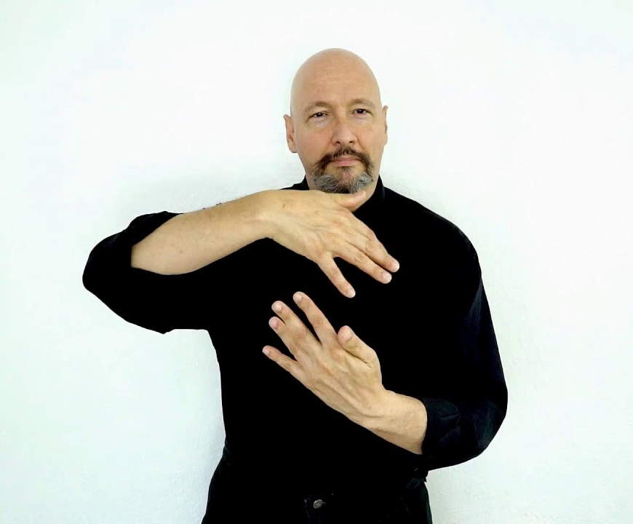
overview
We have created an android app that helps people to communicate with the deaf. This app implements machine learning to translate sign language to letters. we use the android camera to capture the user's hand image and send the image to the cloud to be processed by machine learning and the output will be shown in the app after receiving the result from the cloud. We use Convolution neural Network modeling to perform sign language recognition.
Currently, the sign language that can be recognized by
this system is American Sign Language. Just by capturing motion sign language with your phone's camera, the machine learning model in this app will translate it to you.
In the future this application will be developed to enable two-way communication. The features in this application are also still very potential to be developed and improved reliability. This application was created to facilitate community communication with the deaf, and expand opportunities for them in society.

Slide 3
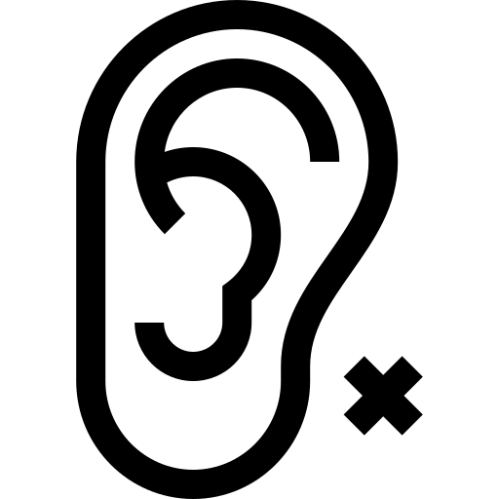
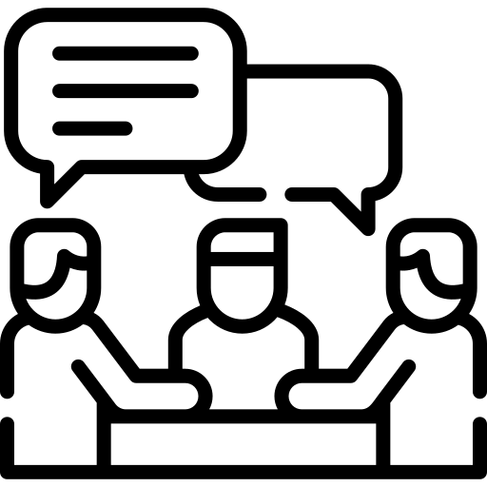
Based on data from the Ministry of Health's Pusdatin in 2019, of all persons with disabilities, 7.03% were deaf and 2.57% were speech impaired. Source : https://pusdatin.kemkes.go.id/resources/download/pusdatin/infodatin/infodatin-tunarungu-2019.pdf
There are still many people who do not understand sign language so that it is difficult for them and the community to communicate with each other.
BACKGROUND

Slide 4
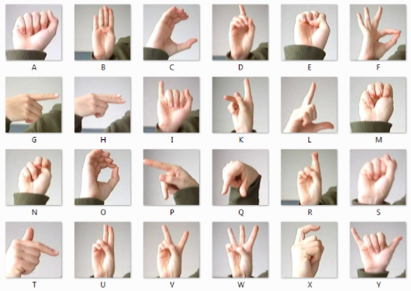
dataset
The dataset format is patterned to match closely with the classic MNIST. Each training and test case represents a label (0 - 25) as a one-to-one map for each alphabetic letter A - Z (and no cases for 9 = J or 25 = Z because of gesture motions). The training data (27,455 cases) and test data (7172 cases) are approximately half the size of the standard MNIST but otherwise similar with a header row of label, pixel1,pixel2….pixel784 which represent a single 28x28 pixel image with grayscale values between 0 - 255
Link Dataset :
https://www.kaggle.com/datamunge/sign-language-mnist/code

Slide 5
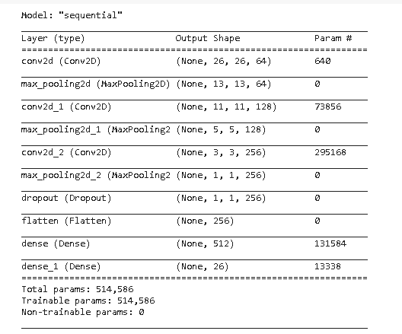
CNN MODEL BASELINE

Slide 6
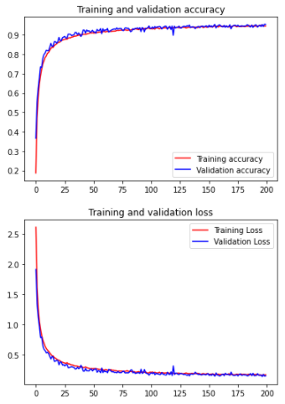
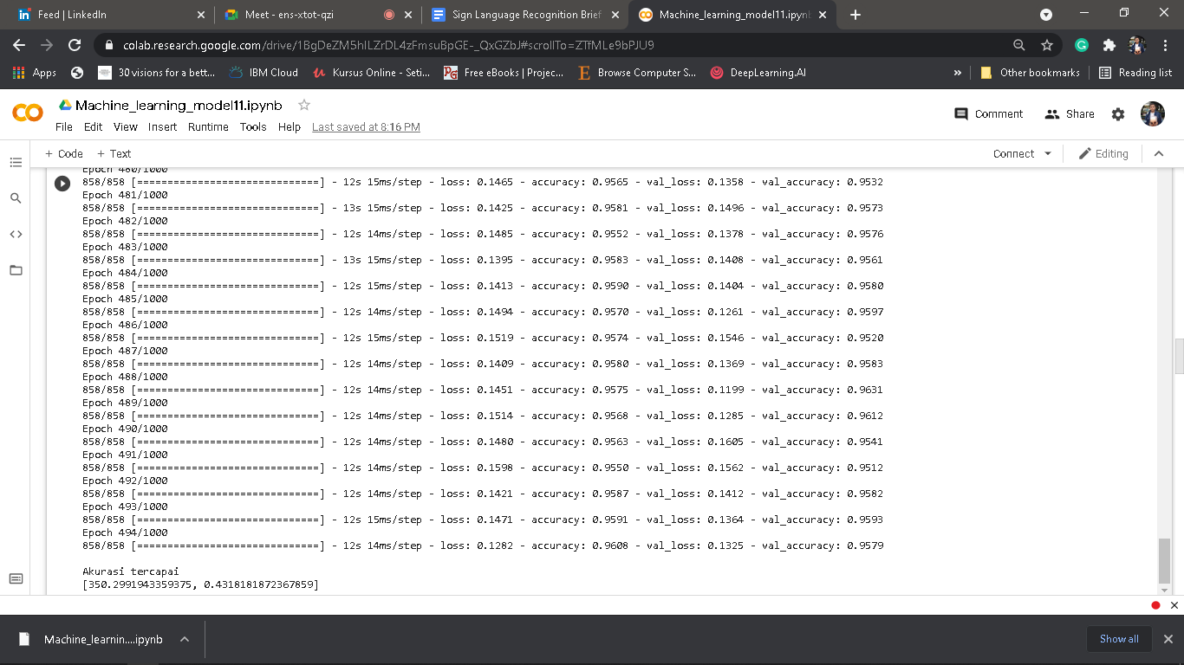
CNN MODEL RESULT

Slide 7
OUR IMPROVEMENT
ADDING DROPOUT LAYER
The Dropout layer randomly sets input units to 0 with a frequency of rate at each step during training time, which helps prevent overfitting

Slide 8

ANDROID IMPLEMENTATION
We are using CameraX to get android camera permission, capturing image, and saving
the captured image to the application storage.

Slide 9
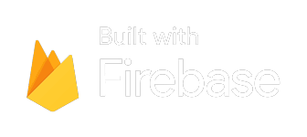
ANDROID IMPLEMENTATION
We send the captured image to firebase storage so the cloud can take the image to
process it on the Machine Learning model and using firebase firestore to save the result.

Slide 10
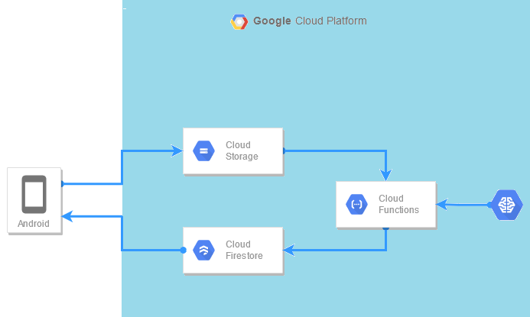
CLOUD’S SCHEMA
Machine Learning Model deployed with Cloud Function as a Serverless Machine Learning.
Cloud Function triggered by finalize/create from Cloud Storage. After Machine Learning predict the input, Cloud Function then forward the result to Cloud Firestore.
Android application upload the image to Cloud Storage to trigger Cloud Function, then Pull the expected result from Cloud Firestore.

Slide 11
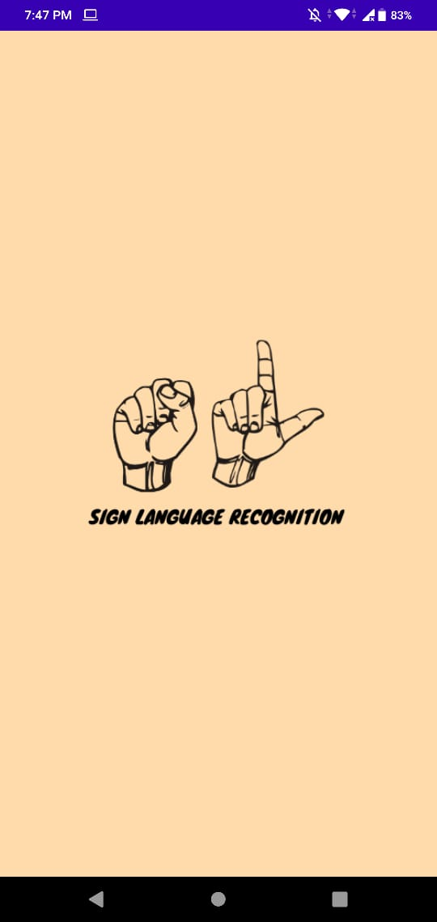
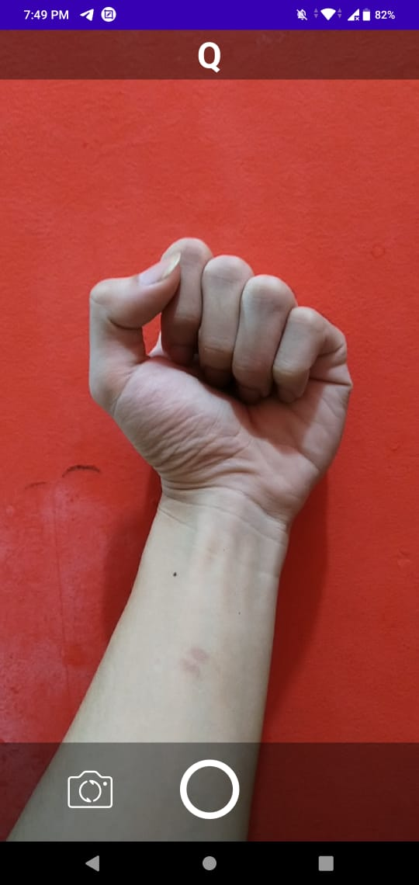
DEPLOYMENT
Our project application deployed only in Github.
https://github.com/envyst/sign-language-application/blob/master/sign-language-app.apk
And the Machine Learning deployed on Google Cloud Platform using Cloud Function as a Serverless Machine Learning.
Using a simple interface, our users can just take a picture about sign language and then get the result of translation from it.

Slide 12
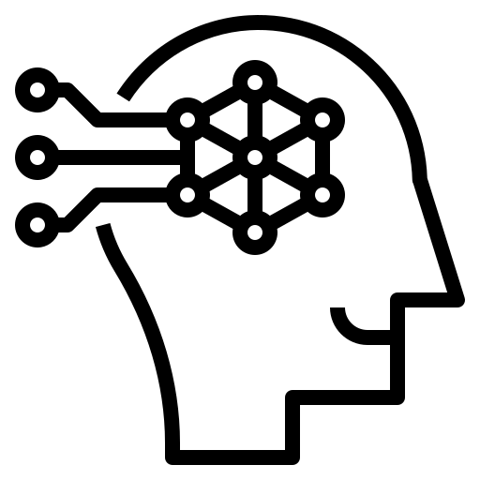

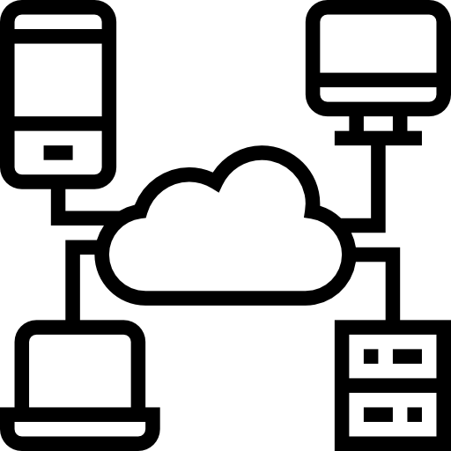
DOCUMENTATION
Machine Learning
1. Download the dataset, then perfom reading on the Notebook (colaboratory)
2. Make sure the dataset is divided into two, training data labels and validation data labels
3. Using ImageDataGenerator, prepare the dataset pipeline and perform image augmentation
4. Create a sequential model of Convolution Neural Network
5. Compile the model, so that it is ready for being trained and validated
6. Train and validate the model
7. Save the model in hdf5 format
Mobile Development
1. Implement CameraX
2. Add camera request permission
3. Implement Firebase to use Cloud Storage for media storage and Cloud Firestore to contain predictions output
4. Add wifi request permission and internet access
5. Move the implementation of firebase to view model
Cloud Computing
1. Make Google Cloud Storage Bucket to store image input from Android
2. Enable Google Cloud Firestore to store output data from Machine Learning model
3. Make Google Cloud Function to deploy a Serverless Machine Learning
4. Test Cloud Function, manually upload image to GCS Bucket
5. Make a monitoring dashboard to check activity of Cloud Function

Slide 13
Your Roadmap
Deploying Application. Machine Learning prediction improvement,
Application maintenance and evaluation, improving services
Application design, Google ads, Demo the apps
Promotion campaign through social media, Active online customer service.

Slide 14
Improve the accuracy of our application in predicting Sign language based on user inputs and Federeated learning
Doing research and start implementating of using video as input for translation
June
July
August
October
December
The finishing of the application prototype and prototype deployment
Adding Features that will improve the usability of the application. Optimizing with new dataset(Data entered by user)

Slide 15
Budgeting - 1 - USD 5k / IDR 70m
Category | Proportion (Max) (%) | Budget (max) (USD)
Team Salary | 24% | $1200
Computer/Laptop | 25% | $1250
Transportation | 8% | $400
Running Test | 10% | $500
Data Collection | 11% | $550
Colloquium | 10% | $500
Office Rent | 12% | $600

Slide 16
Budgeting - 2 - USD 10k / IDR 140m
Category | Proportion (Max) (%) | Budget (max) (USD)
Budgeting 1 | 50% | $5000
Addtional Team Salary | 5% | $500
Market Research | 7% | $700
Marketing and Sales | 19% | $1900
Google Cloud Cost | 7% | $700
Patent | 3,5% | $350
Other Expanses (Tax, Electricity, Reward for employee) | 8,5% | $850

Slide 17


Thank You

